Slide 1
















Lecture No 10

Slide 2
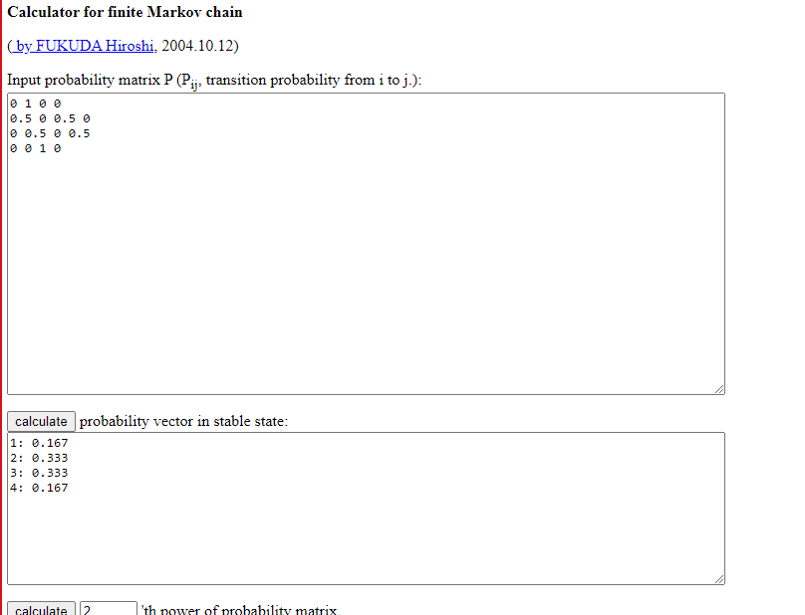



































































Slide 3














































Slide 4

















Slide 5



















Slide 6


















Slide 7























































Slide 8






















































Slide 9













































Slide 10






























Slide 11



Slide 12
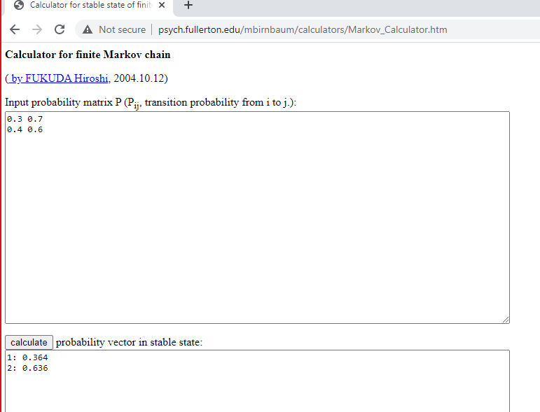




Slide 25






















Slide 27



Slide 28



Slide 29



Slide 30


Slide 31



Slide 32













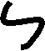







































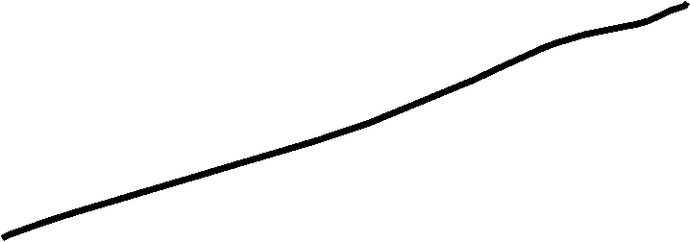















Slide 33





























































Q: suppose the customer enter a certain shop at the rate of 30 person per hour. Using the Poisson distribution calculate the probability that in a 2-minutes interval

Slide 34

























































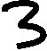

















Slide 35































Slide 36
















































































Q: 3 students came to attend the class today, find the probability for exactly 4 students to attend the class tomorrow?

Slide 37


































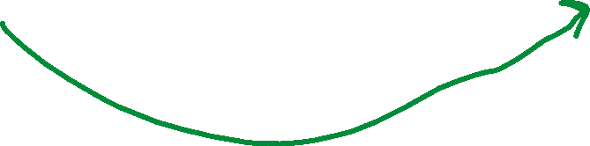








Traffic flows

Slide 38
http://psych.fullerton.edu/mbirnbaum/calculators/Markov_Calculator.htm

Slide 39
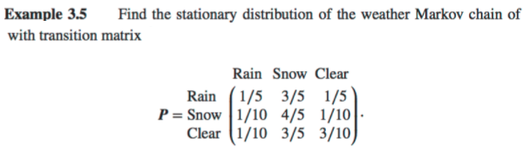

































Slide 40





























































Slide 41




































































Slide 42























































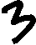



















Slide 43
















